Slide 1
Compositional Human Pose Regression
Xiao Sun
Joint work with Yichen Wei

Slide 2
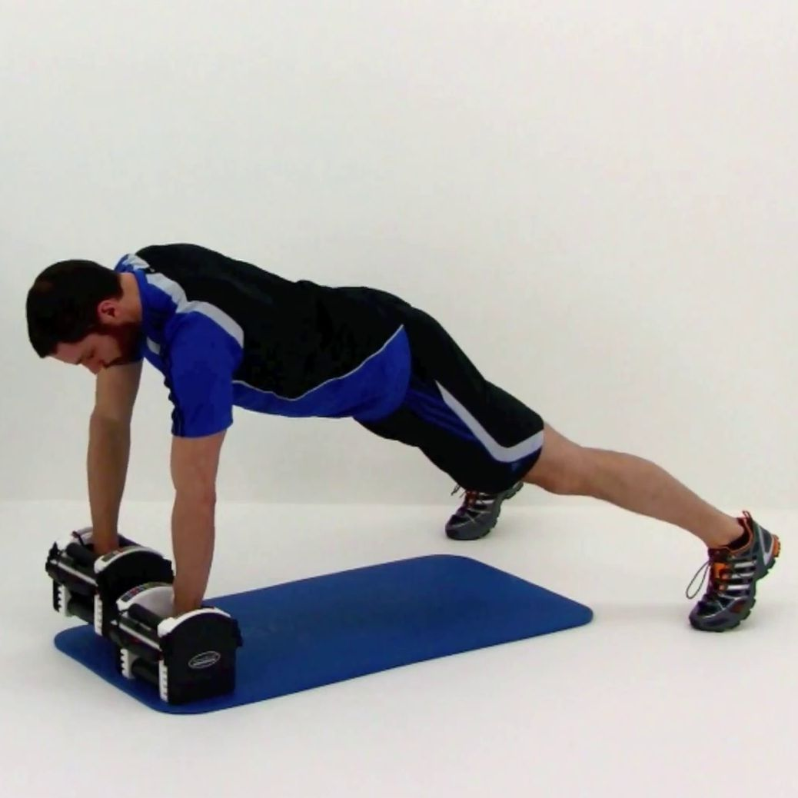
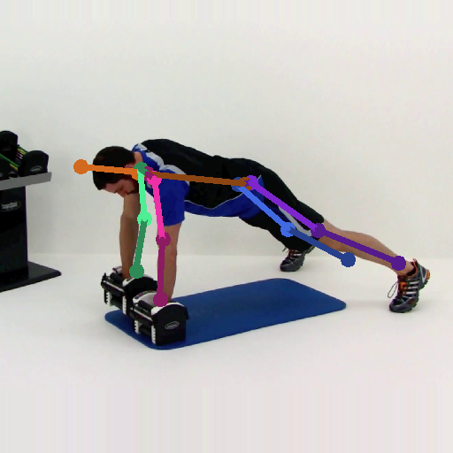
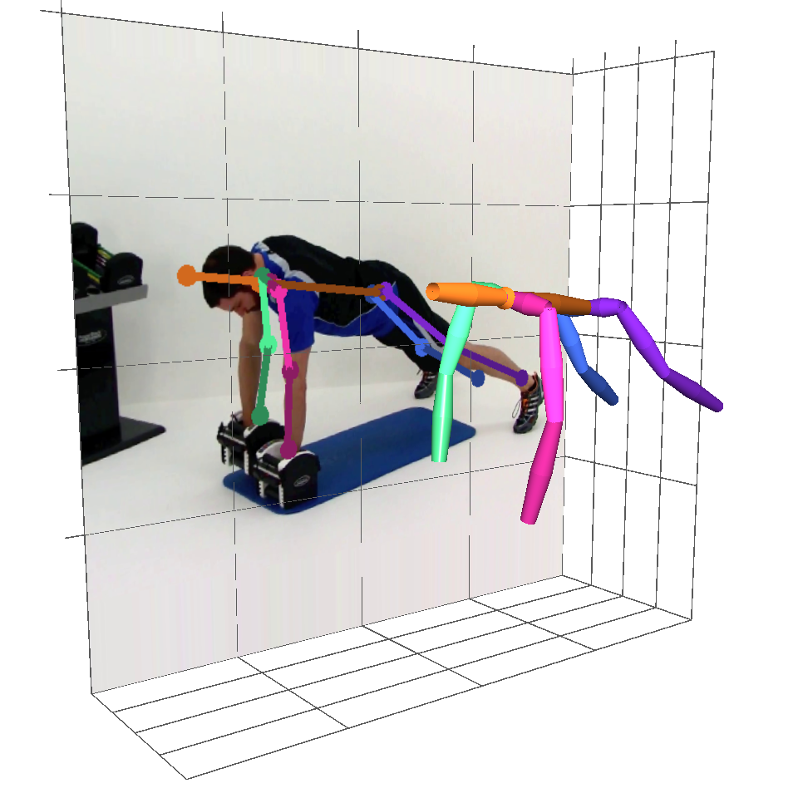
Human Pose Estimation
Problem: localize key points of a person
Input: a single RGB image
Output: 2D or 3D key points
RGB Image (person centered)
Pose Estimator
2D Key Points
3D Key Points

Slide 3
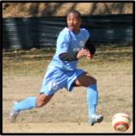
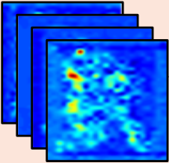
Detection VS. Regression
Detection
Regression
Per-pixel classification
Output: likelihood score maps
Location regression
Output: key points location

Slide 4
Performance
Detection
Regression
Per-pixel classification
Output: likelihood score maps
Used in most 2D methods
State-of-the-art result
Location regression
Output: key points location
Only used in a few 2D methods
Unsatisfactory result

Slide 5
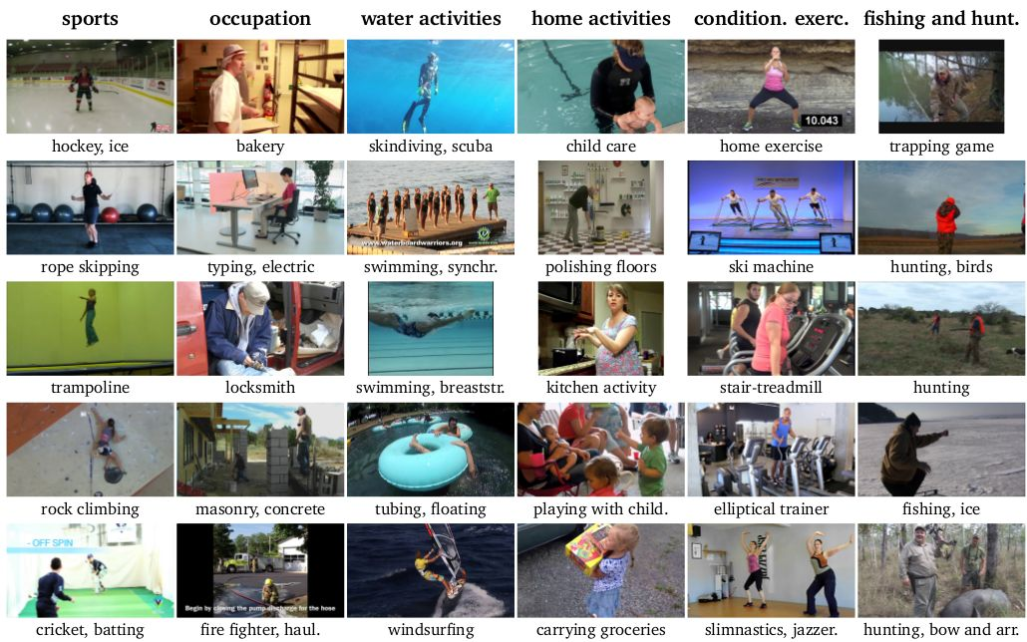
2D Pose Benchmark: MPII dataset
Andriluka et al., 2d human pose estimation: New benchmark and state of the art analysis, CVPR 2014
YouTube videos, 410 daily activities
Complex poses and appearances
25k images, 40k annotated 2D poses

Slide 6
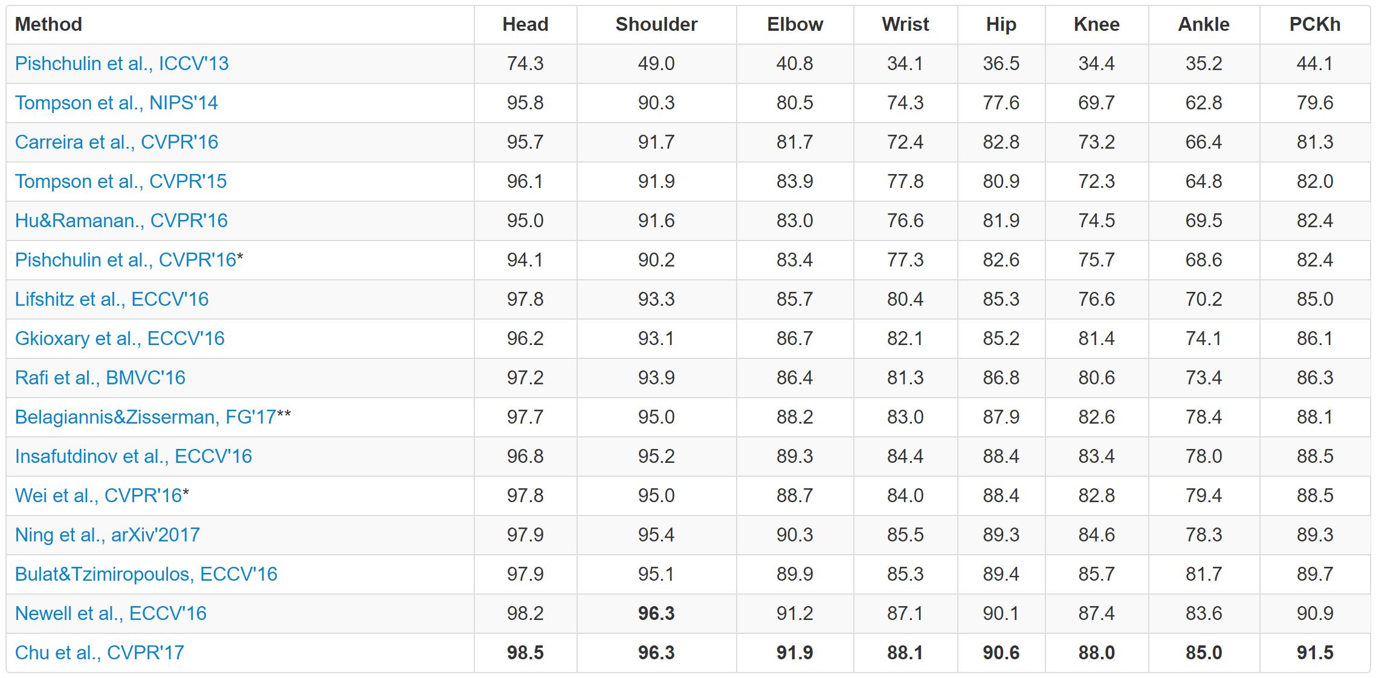
MPII Leader Board
Metric: percentage of correct keypoints (PCK). The higher, the better.
Only one regression method
Not competitive to detection

Slide 7
Reason: exploit joint dependency
Detection
Regression
Per-pixel classification
Output: likelihood score maps
Used in most 2D methods
State-of-the-art result
Scoremap is more expressive
Location regression
Output: key points location
Only used in a few 2D methods
Unsatisfactory result
Dependency not well exploited

Slide 8
Reason: exploit joint dependency
Detection
Regression
Per-pixel classification
Output: likelihood score maps
Used in most 2D methods
State-of-the-art result
Multi-stage, error feedback
Location regression
Output: key points location
Only used in a few 2D methods
Unsatisfactory result
Dependency not well exploited

Slide 9
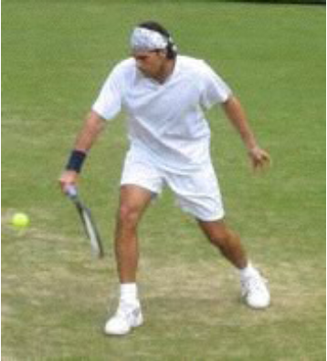
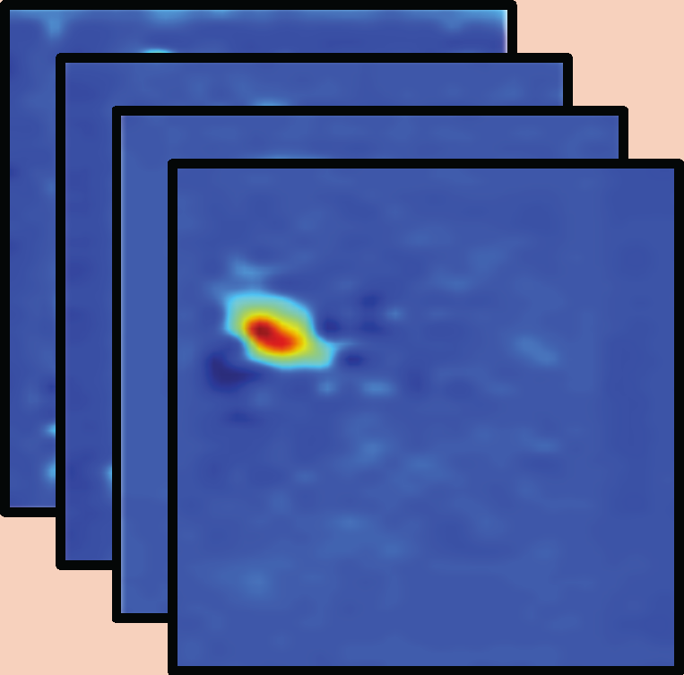
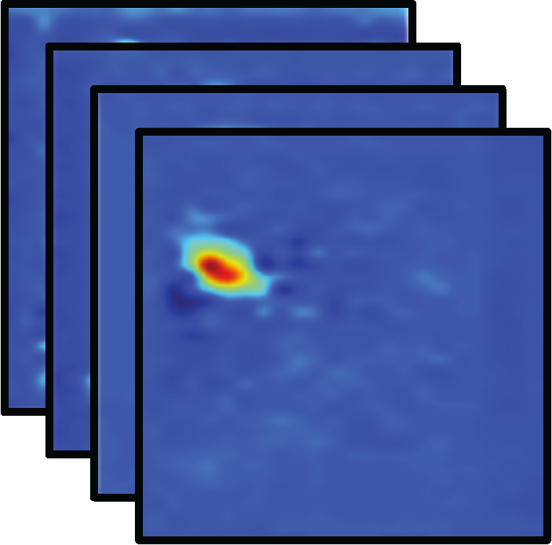
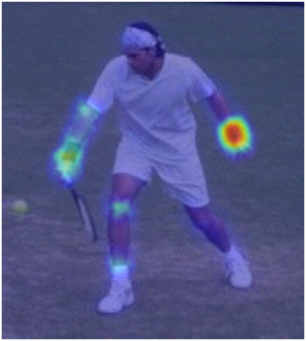
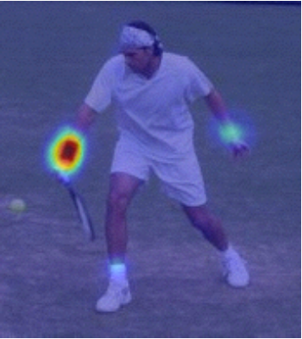
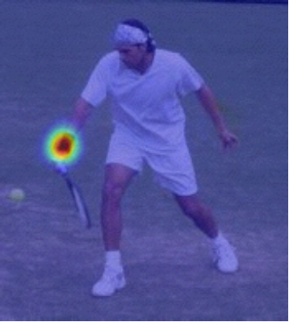
Multi-stage Error Feedback (Detection)
Stage1
Stage2
StageT
CNN
CNN
……
CNN
……
Right Wrist
Right Wrist
Right Wrist

Slide 10
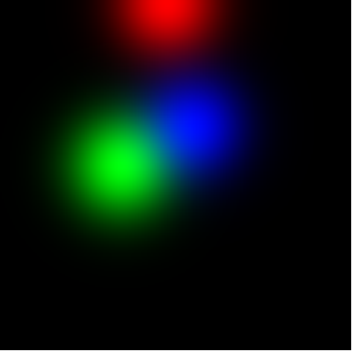
Multi-stage Error Feedback (Regression)
Stage1
Stage2
StageT
CNN
CNN
……
CNN
Gaussian heatmap render
Gaussian heatmap render
Not as good as detection.
Rendered Gaussian maps not expressive
Joint dependency not fully exploit.

Slide 11
Generalization
Detection
Regression
Per-pixel classification
Output: likelihood score maps
Used in most 2D methods
State-of-the-art result
Scoremap is more expressive
Hard to generalize to 3D task
Location regression
Output: key points location
Only used in a few 2D methods
Unsatisfactory result
Dependency not well exploited
General for both 2D and 3D task

Slide 12
Motivation of this work
Detection
Regression
Per-pixel classification
Output: likelihood score maps
Used in most 2D methods
State-of-the-art result
Scoremaps are more expressive
Hard to generalize to 3D task
Location regression
Output: key points location
Only used in a few 2D methods
Unsatisfactory result
Dependency not well exploited
General for both 2D and 3D task

Slide 13
Proposed: structure-aware regression method
A novel pose representation and novel loss function
Better exploit joint dependency
Unified framework for 3D and 2D tasks
Complementary to network architectures
State-of-the-art on both 2D and 3D tasks (ICCV2017 submission)

Slide 14
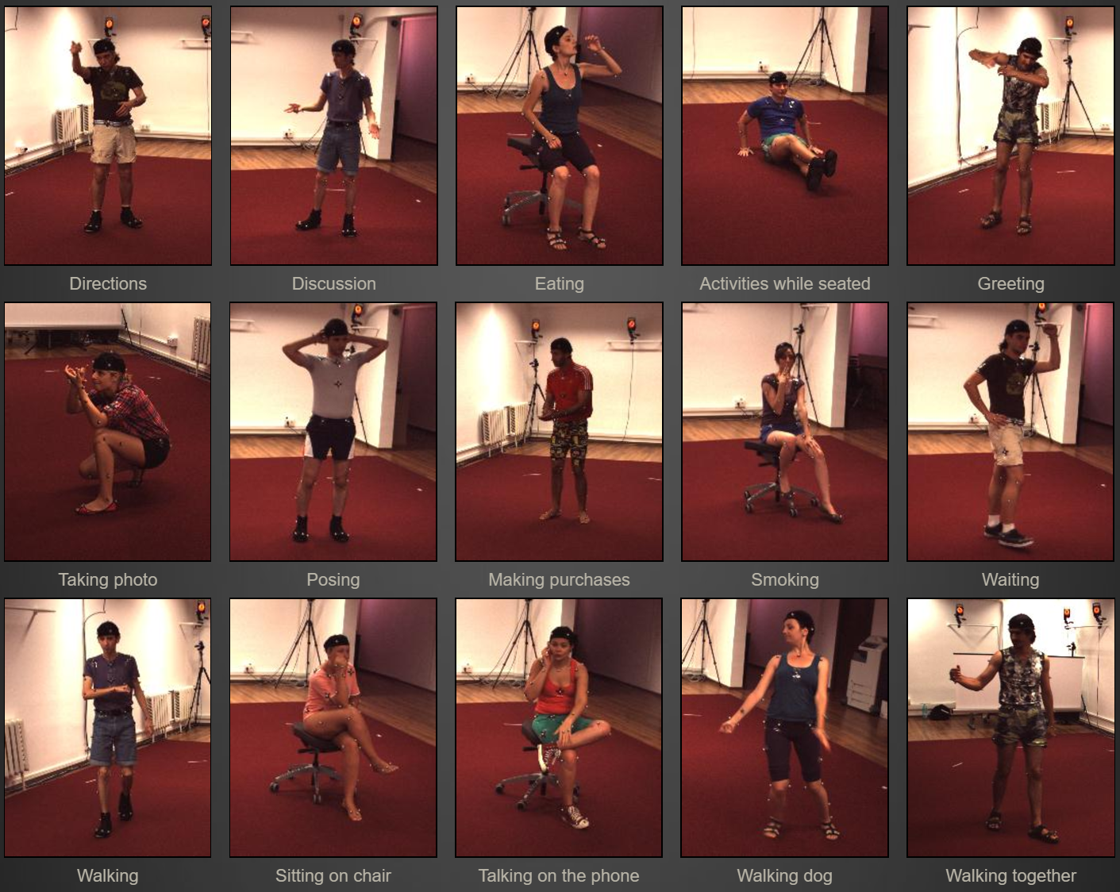
3D Pose Benchmark: Human 3.6M dataset
Lonescu et al., Human3.6m: Large scale datasets and predictive methods for 3d human sensing in natural environments, PAMI 2014
Ground truth by motion capture
7 subjects x 15 actions x 4 cameras
Millions of RGB frames

Slide 15
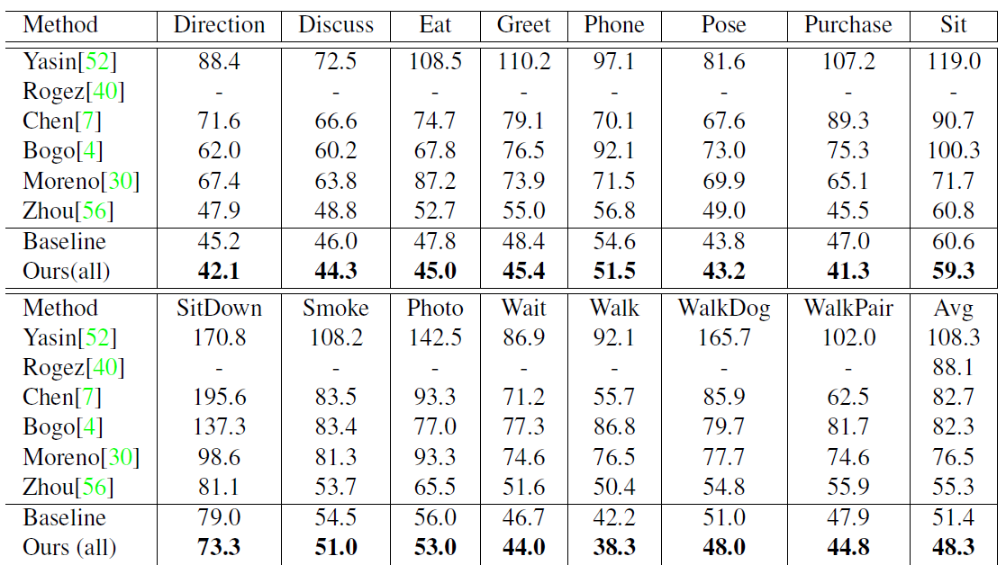
Our Performance (3D)
Dataset: Human3.6M.
Metrics: mean joint position error in mm. The lower, the better.
Advance the state-of-the-art a large margin, 12.7%.
A record of 48.3mm average joint error.

Slide 16
Our Performance (2D)
Dataset: MPII.
Metrics: percentage of correct keypoints (PCK). The higher, the better.
Advance the state-of-the-art regression method 6.3%.
Competitive with the state-of-the-art detection methods.

Slide 17
Two Key Techniques
Bone based pose representation
Simplify the problem
Compositional loss function
Encodes long range interactions between bones

Slide 18
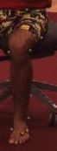
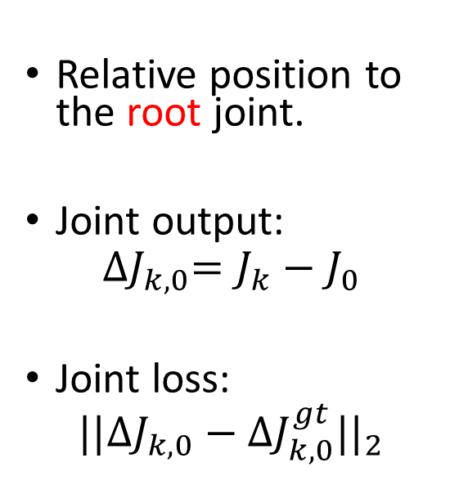
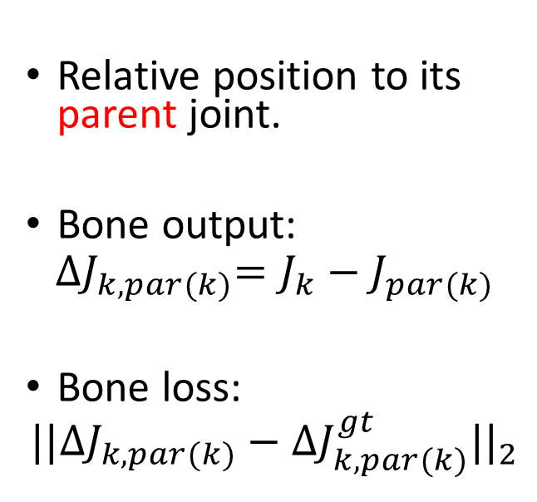
Pose Representation: Joint VS. Bone
Joint
Bone
Relative position to the root joint.
Joint output:
$${∆J}_{k,0}=J_{k}−J_{0}$$
Joint loss:
$${||{∆J}_{k,0}−{∆J}_{k,0}^{gt}||}_{2}$$
Relative position to its parent joint.
Bone output:
$${∆J}_{k,par(k)}=J_{k}−J_{par(k)}$$
Bone loss:
$${||{∆J}_{k,par(k)}−{∆J}_{k,par(k)}^{gt}||}_{2}$$
J0
J0
J1
J1
J2
J2

Slide 19
Joint Representation: Drawbacks
Joints independently estimated
Internal structure not exploited
Geometric constraint not satisfied
Bone length not constant
Joint angle may out of range

Slide 20
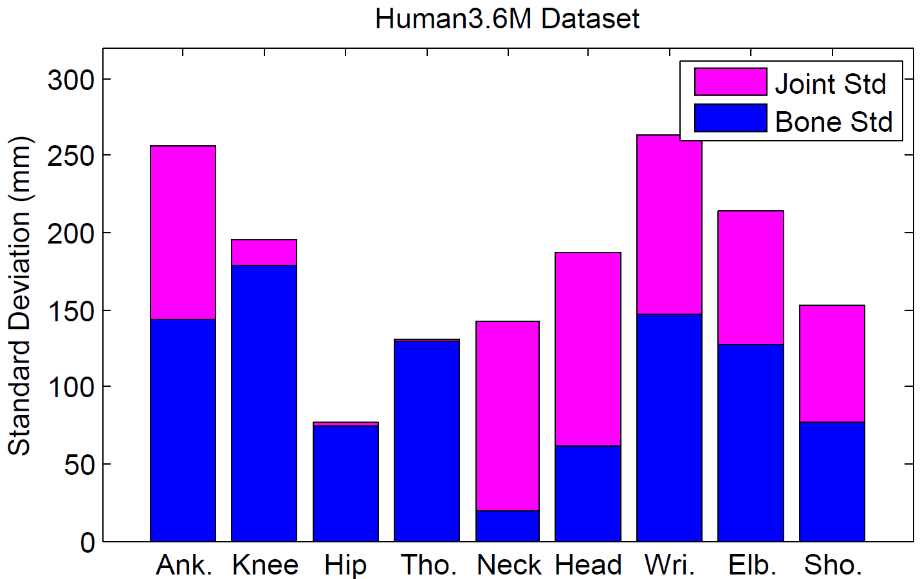
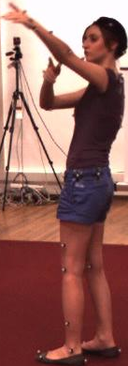
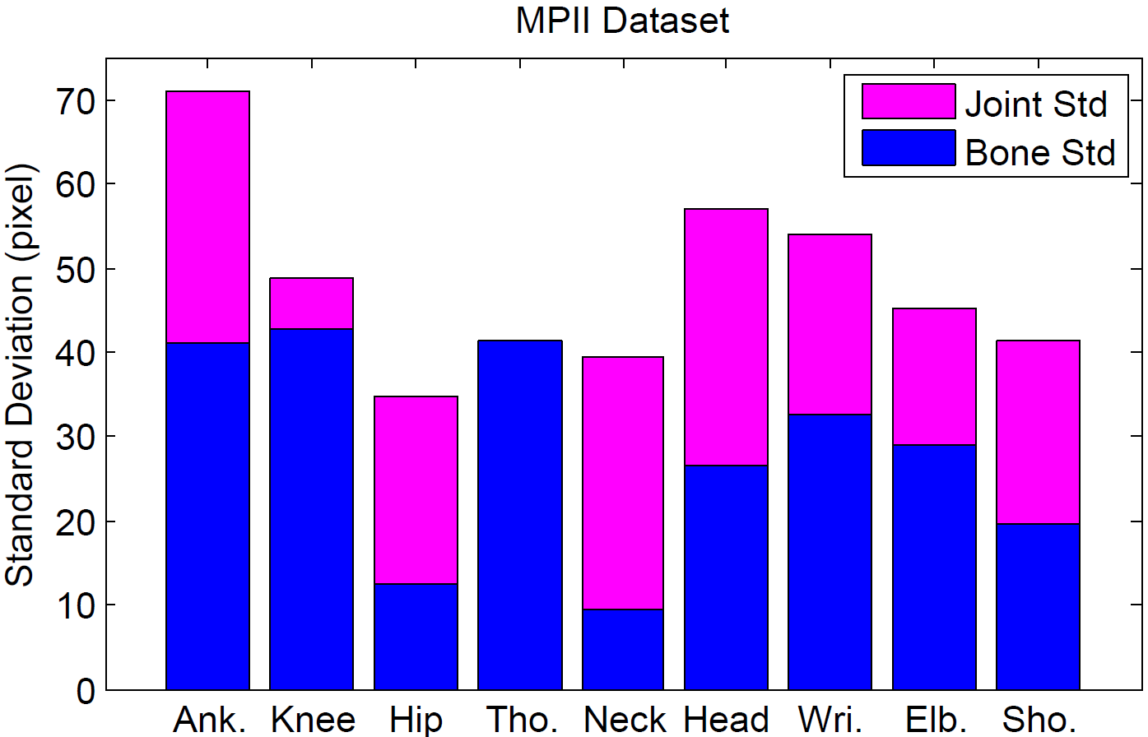
Bone Representation: Advantages
Joints are connected in a tree structure
Bones are primitive units and local
Significantly smaller variance in targets
Application convenience: local motion is enough
Geometric constraint better satisfied
(New evaluation metrics)
Name | Type | Definition
Joint Error | Absolute location | Mean per joint position error.
Bone Error | Relative location | Mean per bone position error.
Bone Std | Physical validity | Bone length standard deviation.
Illegal Angle | Physical validity | Percentage of illegal joint angle.
Gesture: Pointing
Direction of forearm
Standard deviation of bones and joints for the 3D Human3.6M dataset and 2D MPII dataset

Slide 21
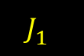
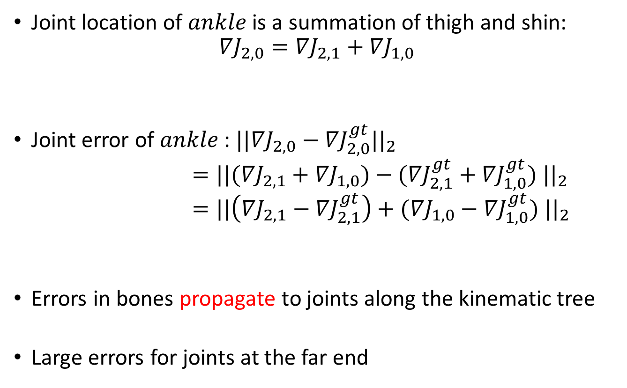
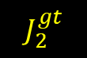
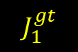
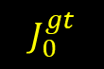
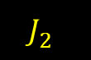
Use Bone Loss Only: Drawback
$$J_{0}^{gt}$$
Joint location of $ankle$ is a summation of thigh and shin:
$${∇J}_{2,0}={∇J}_{2,1}+{∇J}_{1,0}$$
Joint error of $ankle$: ${||{∇J}_{2,0}−{∇J}_{2,0}^{gt}||}_{2}$
$={||({∇J}_{2,1}+{∇J}_{1,0})−({∇J}_{2,1}^{gt}+{∇J}_{1,0}^{gt}) ||}_{2}$
$={||\left({∇J}_{2,1}−{∇J}_{2,1}^{gt}\right)+({∇J}_{1,0}−{∇J}_{1,0}^{gt}) ||}_{2}$
Errors in bones propagate to joints along the kinematic tree
Large errors for joints at the far end
Hip
bone 2
bone 1
$$J_{1}^{gt}$$
Knee
$$J_{1}^{}$$
$$J_{2}^{gt}$$
Ankle
Error in shin
Error in thigh
$$J_{2}^{}$$
Ground truth joint
Ground truth bone
Estimated bone

Slide 22
Motivation
Besides local bone loss only
Long-range losses should also be considered and balanced over the intermediate bones.

Slide 23
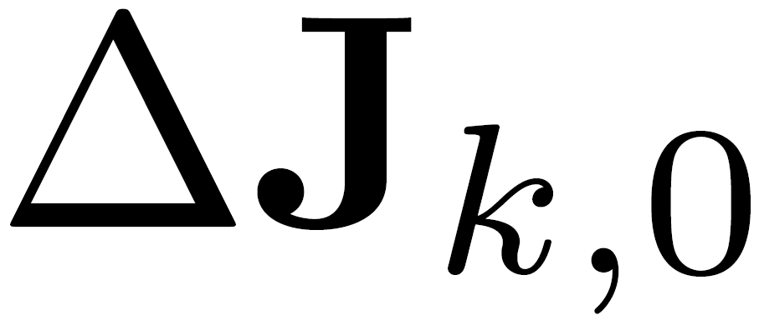
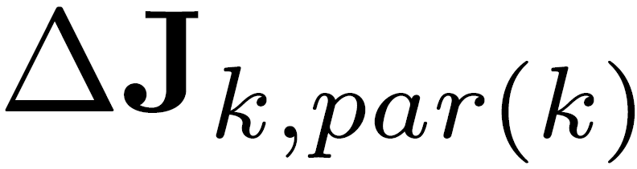
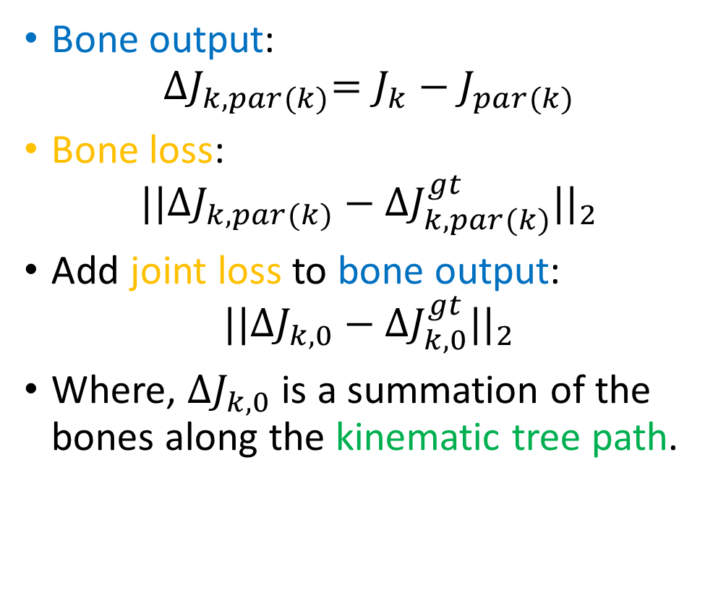
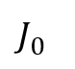
Add Joint Loss to Bone Outputs
Bone output:
$${∆J}_{k,par(k)}=J_{k}−J_{par(k)}$$
Bone loss:
$${||{∆J}_{k,par(k)}−{∆J}_{k,par(k)}^{gt}||}_{2}$$
Add joint loss to bone output:
$${||{∆J}_{k,0}−{∆J}_{k,0}^{gt}||}_{2}$$
Where, ${∆J}_{k,0}$ is a summation of the bones along the kinematic tree path.
$$J_{0}^{}$$

Slide 24
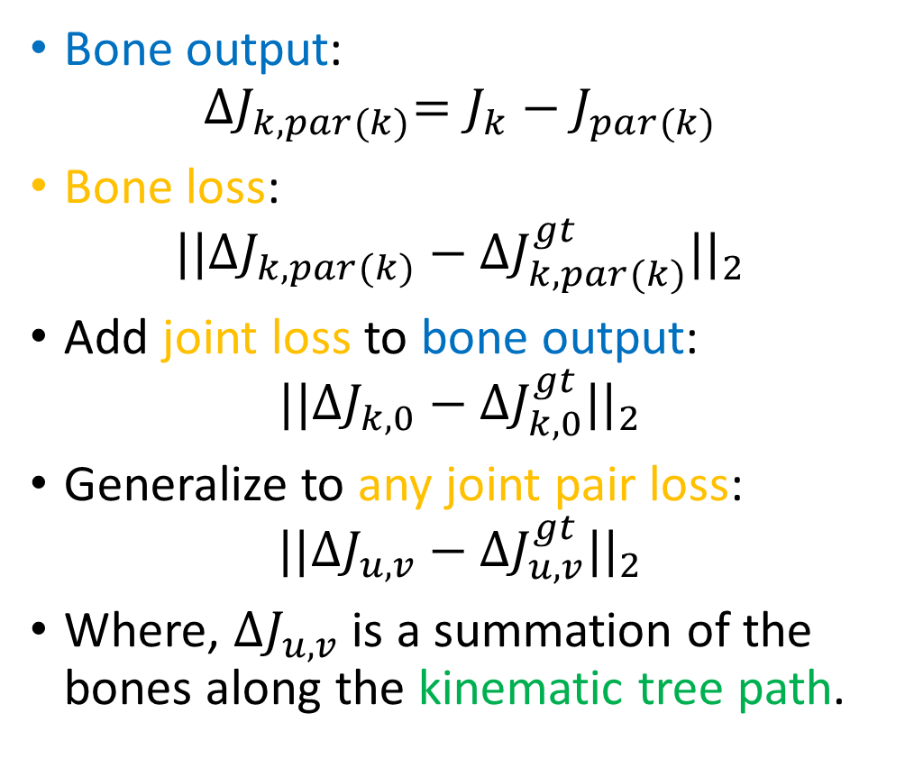
Generalize to Any Joint Pair Loss
Bone output:
$${∆J}_{k,par(k)}=J_{k}−J_{par(k)}$$
Bone loss:
$${||{∆J}_{k,par(k)}−{∆J}_{k,par(k)}^{gt}||}_{2}$$
Add joint loss to bone output:
$${||{∆J}_{k,0}−{∆J}_{k,0}^{gt}||}_{2}$$
Generalize to any joint pair loss:
$${||{∆J}_{u,v}−{∆J}_{u,v}^{gt}||}_{2}$$
Where, ${∆J}_{u,v}$ is a summation of the bones along the kinematic tree path.

Slide 25
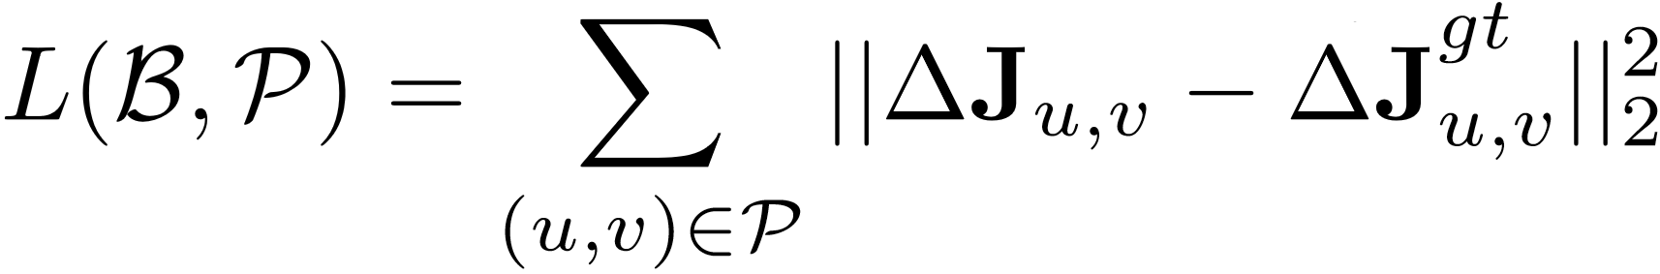
Compositional Loss Function
Regression output: bones
Ground truth relative position
Joint pair set
Relative position of a joint pair, a summation of the bones along the kinematic tree.
The long-range joint pair losses are considered and balanced over the intermediate bones!
The ground truth is sufficiently exploited!

Slide 26
Comparison Experiments
Network: 50-layer ResNet
Dataset:
3D benchmark: Human3.6M
2D benchmark: MPII
Methods:
Notation
Outputs
Loss
State
-
of
-
the
-
art
-
-
Our Baseline
Joints
Joint position
loss
Ours (bone)
Bones
Bone position
loss
Ours (all)
Bones
All joint pair position
loss

Slide 27
3D Human Pose Results
A strong baseline, already state-of-the-art.
Bone representation is superior to joint.
Compositional loss function is effective.
[1] Zhou et al., Deep kinematic pose regression, ECCV 2016.
Metric
State of the art
Baseline
Ours (bone)
Ours (all)
Joint Error (mm)
78.7 [1]
75.0
75.0
(0.0%)
67.5
(
10.0%
)
The lower, the better
Bone Error (mm)
-
65.5
62.3
58.4
(4.9%)
(
10.8%
)
Bone
Std
(mm)
-
26.4
21.9
(17.0%)
21.7
(
17.8%
)
Illegal Angle (%)
-
3.7%
3.3%
(10.8%)
2.5%
(
32.4%
)

Slide 28
Apply to 2D Task (Regression Based)
Stage
Metric
State of the art
Baseline
Ours(all)
Joint Error (mm)
-
29.7
27.2 (
8.4%
)
1
Bone Error (mm)
-
24.8
22.5 (
9.3%
)
Two stage error feedback
PCK (%)
-
76.5%
79.6% (
4.1%
)
Joint Error (mm)
-
25.0
22.8 (
8.8%
)
2
Bone Error (mm)
-
21.2
19.5 (
8.0%
)
PCK (%)
81.3% [2]
82.9%
86.4% (
4
.2%
)
Complementary to “multi-stage error feedback”:
A two-stage error feedback baseline.
Stage1: direct joint regression.
Stage2: use joint prediction from stage1.
Our method improves both stages.
[2] Carreira et al., Human pose estimation with iterative error feedback, CVPR 2016.

Slide 29
Unified 2D and 3D Pose Regression
Our method general for 3D and 2D task.
Easily mixed 3D and 2D data training:
Decompose the loss into xy part and z part.
xy part is always valid for both 3D and 2D samples.
z part is only computed for 3D samples and set to 0 for 2D samples.
Significantly improve 3D pose performance
Joint Error 67.5->48.3, 28.4%.
Plausible and convincing 3D pose on in-the-wild image.

Slide 30
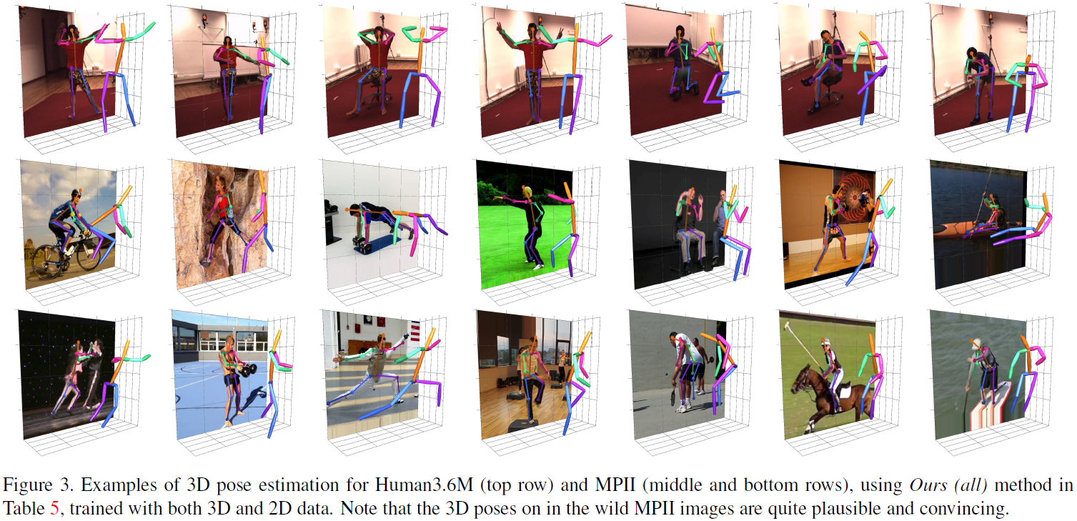
Qualitative Result

Slide 31
Video Result

Slide 32
Future Work
More sophisticate geometric structure representation.
Ambiguity and multiple hypothesis.
Video consistency and smoothness.
Unified framework for human detection, 3D human pose, attribute and action.

Slide 33
Thanks!

